Slide 1
QnA
Freshman Seminar
2022.02.25.
Sumin Sohn

Slide 2
The Relationship between Window Size and Sequence Number
The problem occurs when the window size is too big compared to the sequence numbers
Since GBN and SR work differently, there must be different size needed

Slide 3
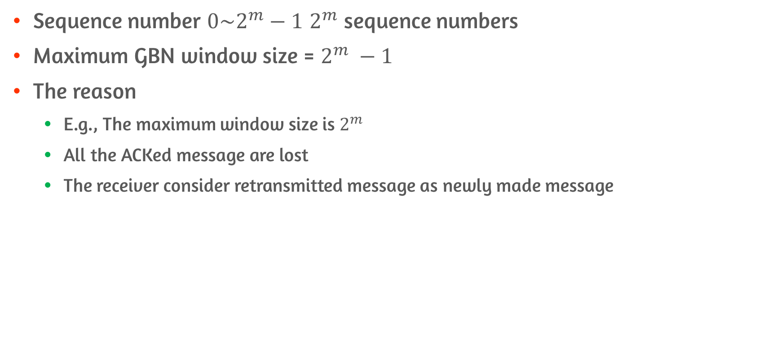
GBN Case
Sequence number $0\sim 2^{m}−1$ $2^{m}$ sequence numbers
Maximum GBN window size = $2^{m} −1$
The reason
E.g., The maximum window size is $2^{m}$
All the ACKed message are lost
The receiver consider retransmitted message as newly made message

Slide 4
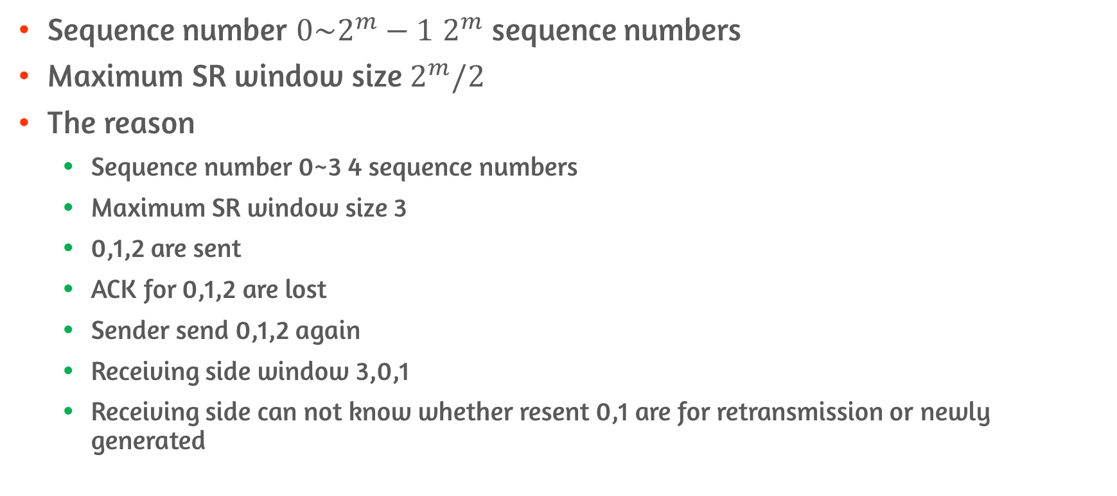
SR Case #1
Sequence number $0\sim 2^{m}−1$ $2^{m}$ sequence numbers
Maximum SR window size $2^{m}/2$
The reason
Sequence number 0~3 4 sequence numbers
Maximum SR window size 3
0,1,2 are sent
ACK for 0,1,2 are lost
Sender send 0,1,2 again
Receiving side window 3,0,1
Receiving side can not know whether resent 0,1 are for retransmission or newly generated

Slide 5
SR Case #2
If SR windows size is 2 on previous example
The result
Sequence number 0~3, 4 sequence numbers
SR window size 2
0,1 are sent
ACK for 0,1 are lost
Sender send 0,1 again
Receiver knows 0,1 is retransmitted message since widow on recipient side directs 2,3

